Slide 1
Accounting in Action
Prepared By
Maisha Tasnim
Lecturer
Dept. of Arts & Science
Ahsanullah University of Science & Technology

Slide 2
What is Accounting?
Accounting consists of three basic activities-
To identify, record, and communicate the economic events of an
organization to
interested users.

Slide 3
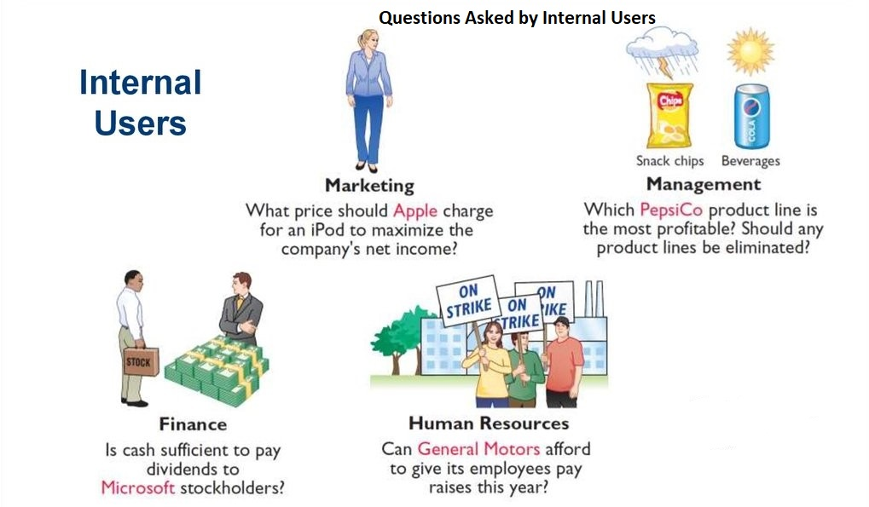
Uses & Users of Accounting Information
There are two broad groups of users. users of financial information: internal users and external
Internal Users: Internal users of accounting information are managers who plan, organize, and run the business.

Slide 4
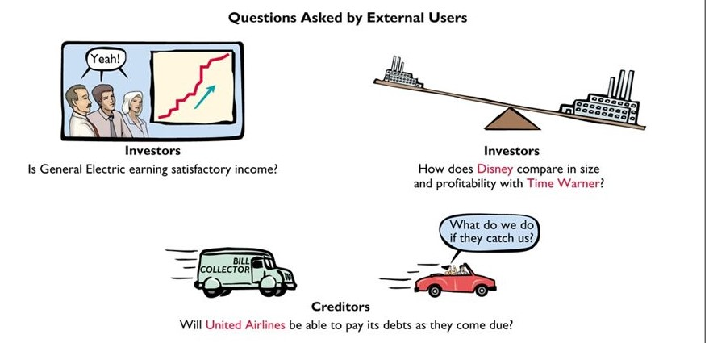
Uses & Users of Accounting Information
External Users:
Individuals and organizations outside a company who want financial information about the company.

Slide 5
Branches of Accounting
There is two major branches of accounting. They are Financial Accounting & Managerial Accounting.
Financial Accounting: Financial accounting involves recording and classifying business transactions, and preparing and presenting financial statements to be used by internal and external users.
Managerial Accounting: Managerial and management accounting focuses on providing information for use by internal users, the management.
There are other types of accounting as well such as Cost Accounting, Forensic Accounting. Tax Accounting etc.

Slide 6
Difference between Financial & Managerial Accounting
Particulars | Financial | Managerial
Users | External & Internal | Only internal
Types of Reports | Statement of Profit & Loss, Statement of Financial Position etc. | Job Cost Report, Cost of Goods Sold Report, Production Cost Report
Frequency | Reported annually, semi-annually, and quarterly. | When needed
Purpose of the reports | To help the external users in making decisions. | To help the management in making plans and maintaining controls.

Slide 7
Basic Objectives of Accounting Information
Compliance with Statutory Requirements
Safeguarding of Interest of Various Stakeholders
Helps in the Measurement of profit and Loss of Business
Presentation of Historical records
Periodic Reporting and Wide Availability
Reliability and Relevance
Easy to Understand

Slide 8
Qualitative Characteristics of Accounting Information
Fundamental Characteristics
RELEVANCE
FAITHFUL REPRESENTATION
Enhancing Characteristics
VERIFIABILITY
TIMELINESS
UNDERSTANDABILITY
COMPARABILITY

Slide 9
Conceptual Framework and GAAP
Conceptual Framework of Accounting refers to the rule and standards that set the nature, function and limits of financial accounting and financial statements. This is developed by International Accounting Standards Board (IASB).
GAAP (Generally Accepted Accounting Principles): The primary accounting standard-setting body in the United States, the Financial Accounting Standards Board (FASB) has developed GAAP which is also a set of rules and standards set for the companies in the USA.

